Slide 1







Integrating Family History Into The Electronic Health Records (EHR)
Marcus Cozza

Slide 2
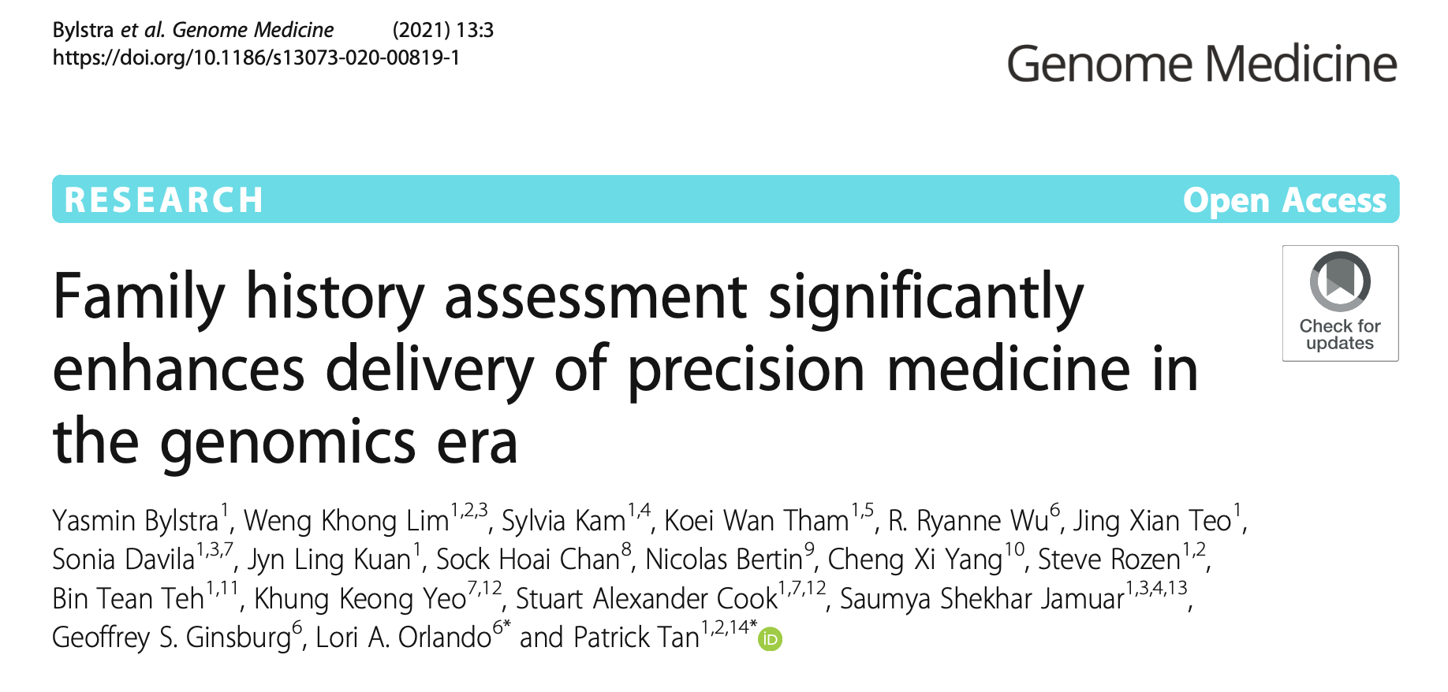
Introduction
Collecting and analysing a person's family history and genetic information can help identify people at high risk of certain health conditions.

Slide 3
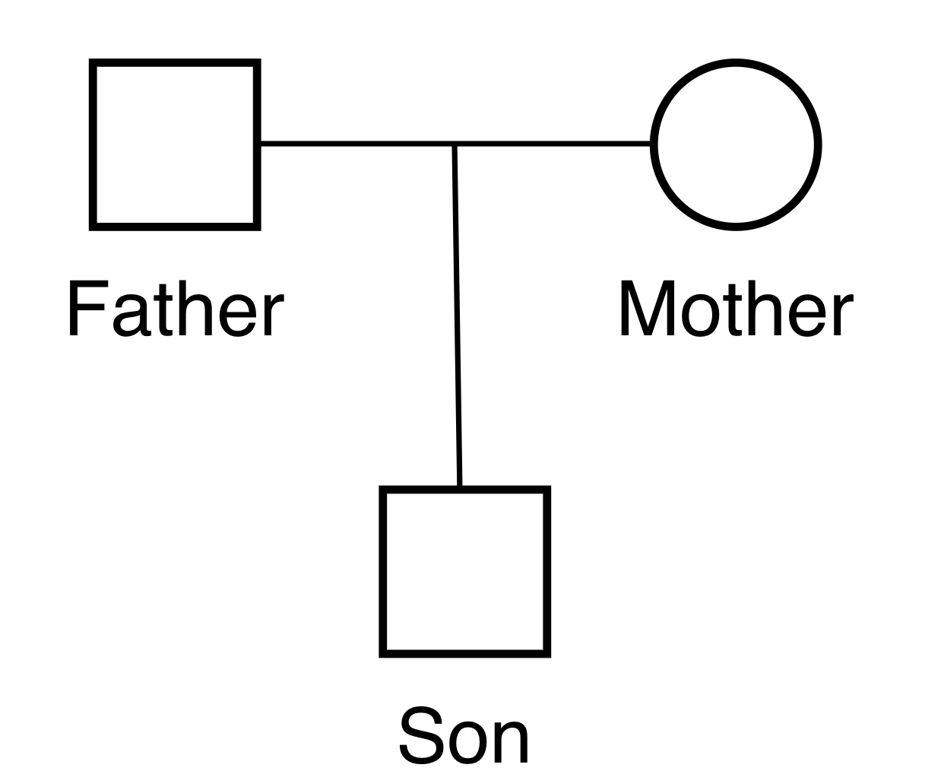
Family History Representation
Pedigree: A diagram of family history that uses standard symbols
Pedigrees are used to track the inheritance of traits or diseases over generations.
Digital Pedigree

Slide 4

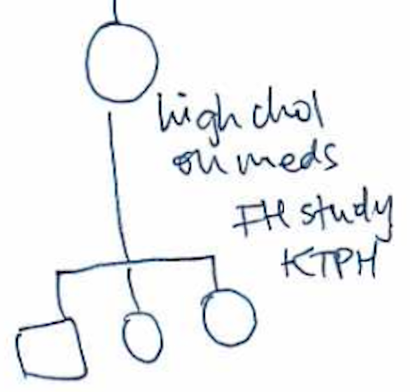

Current Process
Medical Visit With Patient
Hand-drawn Pedigree
Digitalise Hand-drawn Pedigree Into EHR
Convert Digital Pedigree To Standard File (PED)

Slide 5
Problem
Manual work to convert digital pedigree to PED
Mistakes can happen
Takes a long time to convert manually for humans
1
2
3
PED File
Individual ID | Paternal ID | Maternal ID | Sex | Phenotype
1 | 0 | 0 | M | Uninfected
2 | 0 | 0 | F | Uninfected
3 | 1 | 2 | M | Uninfected

Slide 6


Solution
Digital Pedigree
Label & Train A Custom Object Detection Model To Find Pedigree Symbols
Use Optical Character Recognition or Image Analysis To Extract Relationships
Convert To PED

Slide 7
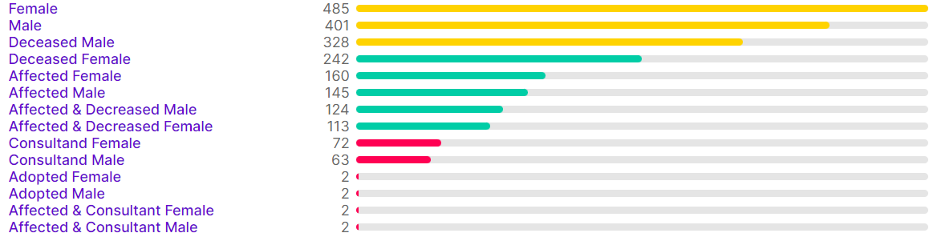
Object Detection Model – Labelling
142 total pedigrees images to label
2,200 total labels drawn
14 different symbols
Breakdown Of Classes

Slide 8
Object Detection Model – Training
Custom trained a Object Detection Model on our data set.
The model returns a JSON object that contains location, box size and type of symbol.
Male – 0.88
Female – 0.85
Male – 0.84

Slide 9
1st Relationship Extraction – Optical Character Recognition
Optical Character Recognition (OCR): converts a text of an image into a string
We extract an image of each text below the symbol
Take the extracted image and run Pytesseract, a library that converts text images into a string.
We can take the extracted text and form the relationships for each individual.
“Father”
“Mother”
“Son”

Slide 10
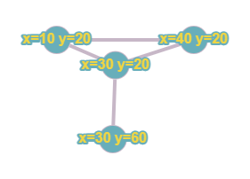
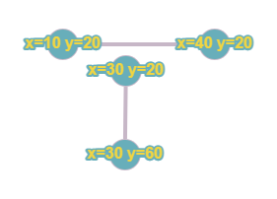
2nd Relationship Extraction – Image Analysis
Find lines that connect pedigree symbols
Remove symbols
Use Probabilistic Hough Line Transformation to find lines which returns coordinates of the line
Create a graph to store lines
Nodes: end of line coordinate
Edges: coordinates of lines
Connect intersecting/close nodes to the each other
Male – 0.88
(x1, y1)
Female – 0.85
(x2, y2)
Male – 0.84

Slide 11
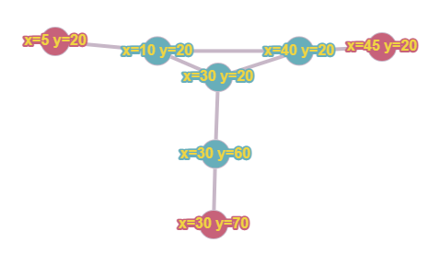
2nd Relationship Extraction – Image Analysis
We find the closest node to our pedigree symbols and connect an edge.
Find the shortest paths from each symbol node to each other and eliminate certain paths that can’t be possible such as on the same Y level.
Extract relationships for each node

Slide 12
Relationship Extraction Comparison
Relationship Extraction Methods | Optical Character Recognition | Image Analysis
Accuracy | Higher | Lower
Need Text | Yes | No
Hand-Written text | Yes/No | N/A
Complexity | Simple | Hard

Slide 13
Relationship Extraction - Relationships

Slide 14
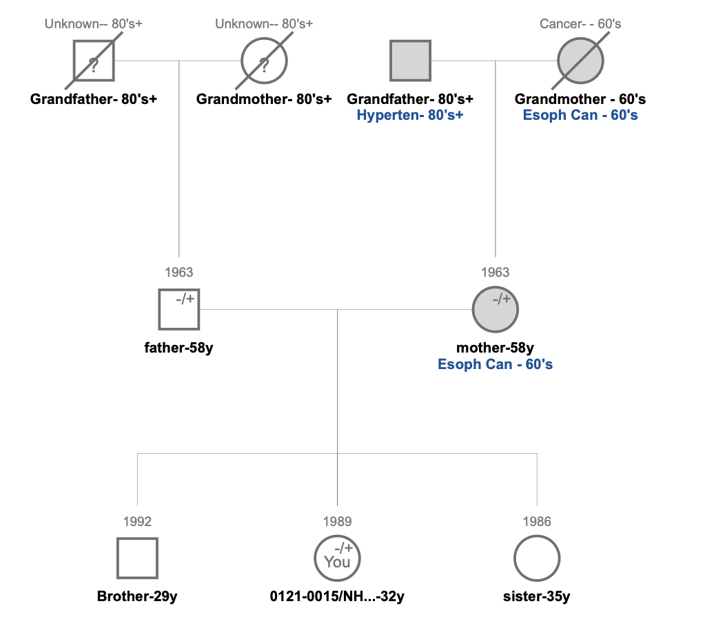
Final Solution
Individual ID (xCord-yCord) | Paternal ID (xCord-yCord) 0 = None | Maternal ID (xCord-yCord) 0 = None | Sex 1 = M 2 = F | Phenotype 1: Uninfected 2: Infected
594.0-87.0 | 0 | 0 | 1 | 2
846.0-89.5 | 0 | 0 | 2 | 2
139.5-87.0 | 0 | 0 | 1 | 1
385.5-87.5 | 0 | 0 | 2 | 1
256.5-445.5 | 139.5-87.0 | 385.5-87.5 | 1 | 1
720.0-448.5 | 594.0-87.0 | 846.0-89.5 | 2 | 2
778.5-809.5 | 256.5-445.5 | 720.0-448.5 | 2 | 1
198.5-809.0 | 256.5-445.5 | 720.0-448.5 | 1 | 1
489.0-808.5 | 256.5-445.5 | 720.0-448.5 | 2 | 1

Slide 15

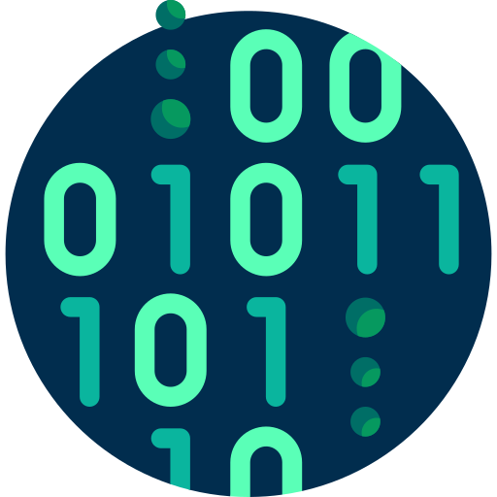
Improvements For The Future
Improve The Object Detection Dataset
Hand-drawn Images
Family Tree Analysis

Slide 16
Conclusion & Big Picture
Successful create a custom object detection model for pedigree symbols
Successful find the relationship of an individual
Successful in converting an pedigree image to a PED for further analysis
Integrate PED into the EHR system as a standard output
Automatic analysis of family history in the EHR

Slide 17

THANKS!
Acknowledgement Of Supervisors
KKH & PRISM
Dr Sonia Davila
Dr Lim Weng Khong
Ms Yasmin Bysltra
Ms Simone Ng
Dr Saumya Jamuar
Ms Sylvia Kam
Ms Lim Jiin Ying
Ms Jasmine Goh
Do you have any questions?
Marcus Cozza
marcuscozza.com
marcus.cozza@student.curtin.edu.au
Curtin University
Dr Susannah Soon
Dr Hui Xi
Dr Tele Tan
CIRB 2019/2243

